Slide 1
Galaxy morphological classification
An analysis of large spectral and photometric datasets
Son pham
4/1/22

Slide 2
Overview
Large volumes of data of the celestial sky are being generated by telescopes and satellites around the world each day
Hubble: ~120GB each week
SDSS: ~200GB each DAY
SDSS Data Release 17 (Incremental): ~600TB
Most datasets remain in storage with hidden treasures still yet to be discovered
1000’s of black holes in the Milky Way was recently discovered using data from decades ago generated by the Chandra satellite
As big data analytics continue to grow, these discoveries will become more common as scientists continue to collect and process more of the data that is available.

Slide 3
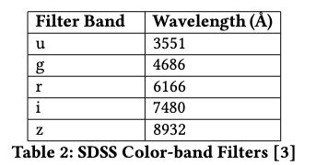
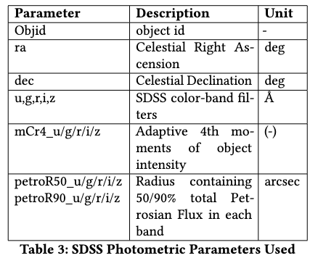
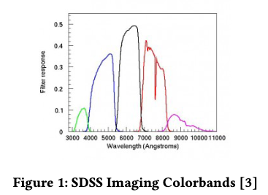
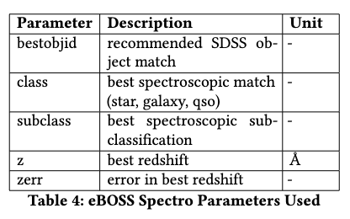
Datasets
Goal is to conduct galaxy morphological classification using datasets of sky surveys
Main source is the Sloan Digital Sky Survey
Provides data for one-third of the entire celestial sphere
Latest release in Dec. 2021
Photometric attributes used for color-bands and shape determination
Spectroscopic attributes for classification using redshift
SuperCOSMOS - additional photometric Schmidt survey plates data
Other useful datasets exists (imaging, infrared, etc) may be used in the project

Slide 4
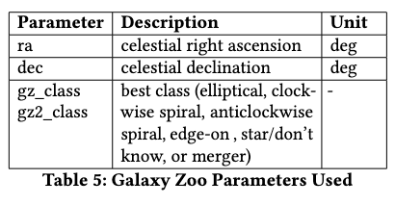
Datasets
Galaxy Zoo 1/2 provides galaxy morphological classification data
Elliptical, cw/anti-cw spiral, edge-on, merger

Slide 5
Approach
Retrieving data
Many sources use Flexible Image Transport System (FITS) or CSV formats
Can download bulk data from their repositories or pull relevant data using SQL
Looked into both methods, but ultimately focused on SQL queries for simpler data cleaning
Query relevant attributes from SDSS photometric datasets, eBOSS spectrometric datasets
GalaxyZoo data is downloaded in bulk
FITS File Structure

Slide 6
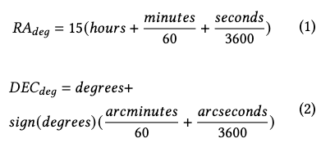
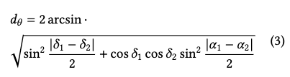
Approach
Data Preprocessing
Some datasets have celestial coordinates in standard format (HMS and DMS) and must be converted to right ascension and declination
At the moment, remove objects from SDSS photometric dataset that are not galaxies (easy processing); will include in the future
Cross-matching:
To integrate into a common database, use celestial coordinates from first dataset and find closest match in remaining datasets using the angular distance between them (haversine formula)
Since these datasets contain millions of datapoints, an efficient cross-matching algorithm was needed
Method 1: use Numpy’s array structure to auto-loop through the catalogs - slowed down significantly for datasets > 10 million objects
Method 2: constrain the search within a neighborhood of the current object of interest, and using a binary split search - speed boost compared to method 1, but slows down for datasets > 100 million objects
Method 3: use k-d tree similar to the binary search algorithm - significant speed relative to other methods for large datasets
HMS/DMS to RA/DEC
Haversine formula
K-d Tree

Slide 7
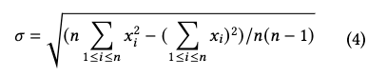
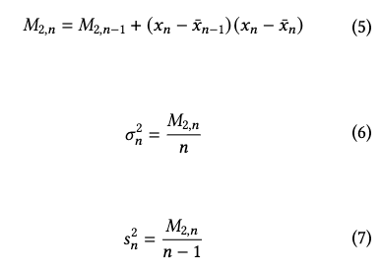
Approach
Exploratory Analysis
Standard analytical evaluation of statistical formulas requires an entire batch of data samples to be stored in memory for computation
Stream processing is needed to run calculations as data comes in and releases memory of previous data
Welford’s method is used for statistical analysis to compute estimates of statistical data without storing all data in memory
Keeps running sum of the data, # of samples, and deviation from data collected so far
Standard deviation
5: Welford recurrence formula 6: Computation of the mean 7: Standard deviation

Slide 8
Approach - next steps
Model Training
Compute GINI indices to determine important attributes
Build decision tree as an exploratory (vanilla) pattern search and initial morphological classification
Build regression models to predict redshift and classify galaxies (using full datasets)
Look at other possible algorithms for model training
Improve efficiency of model training
Improve accuracy of results

